Slide 1
DRIVER’S BLIND EYE DETECTION
LEKSHMI SREE R S
960521104035
CAPE INSTITUTIONS OF TECHNOLOGY

Slide 2
PROBLEM STATEMENT
Despite advancements in automotive safety, accidents due to driver distraction persist. A key factor is the driver's inability to maintain continuous visual focus on the road. To prevent accidents, there's a critical need for a reliable Driver's Blind Eye Detection System. This system must accurately identify instances where the driver's eyes are diverted from the road due to drowsiness, distraction, or other factors, issuing timely warnings to avert potential accidents.

Slide 3
PROPOSED SYSTEM APPROACH
System Development Approach:
Requirements Analysis
Research and Prototyping
Hardware Development
Software Development
Testing and Validation
Integration and Deployment
Iterative Improvement

Slide 4
ALGORITHM AND DEPLOYMENT
Algorithm and Deployment:
1. Algorithm Development:
- Develop eye-tracking algorithms to analyze blink frequency, gaze direction, and pupil dilation.
- Implement real-time processing for timely detection of driver distraction or drowsiness.
- Integrate machine learning to differentiate intentional and unintentional eye movements.
2. Deployment:
- Integrate hardware and software components into a cohesive system architecture.
- Ensure compatibility and seamless integration with existing vehicle safety systems.
- Deploy the system in vehicles for testing and validation in real-world driving scenarios.

Slide 5
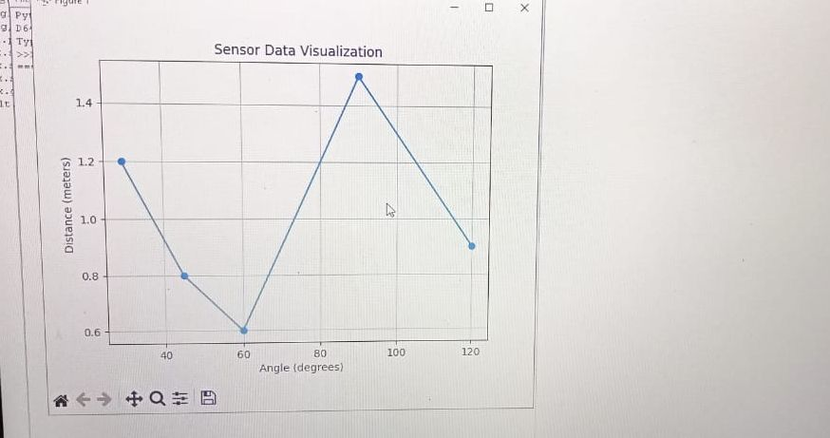
RESULTS

Slide 6
CONCLUTION
Conclusion:
The Driver's Blind Eye Detection System offers a vital solution to mitigate accidents caused by driver distraction. Through innovative hardware and software integration, it accurately tracks eye movements and issues timely alerts, enhancing road safety. Deployment in vehicles for real-world testing validates its effectiveness, marking a significant step towards safer driving experiences.

Slide 7
REFERENCES
Here are the links to install the mentioned Python libraries in the code:
1. [OpenCV](https://pypi.org/project/opencv-python/)
2. [PyTorch Official Website](https://pytorch.org/get-started/locally/)
3. [Imutils](https://pypi.org/project/imutils/)
4. [Pandas](https://pypi.org/project/pandas/)
5. [NumPy](https://pypi.org/project/numpy/)

